Slide 1
TRAINING MODELS
Main reference: Chapter 4 of Géron, A. (2019). Hands-on machine learning with Scikit-Learn, Keras, and TensorFlow.

Slide 2


Slide 3











Motivation
Having a good understanding of how things work can help you

Slide 4


Train Linear Regression models

Slide 5


Train Linear Regression (LR) models
Two ways:
Use “closed-form” equation:
Use a local search approach, called Gradient Descent (GD):

Slide 6
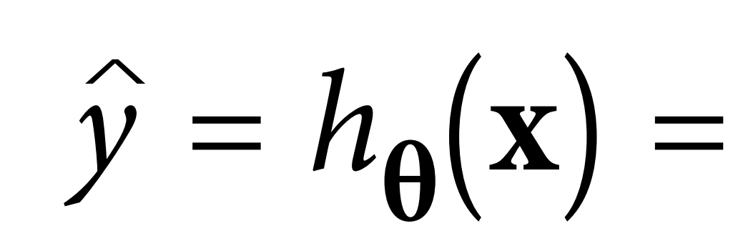
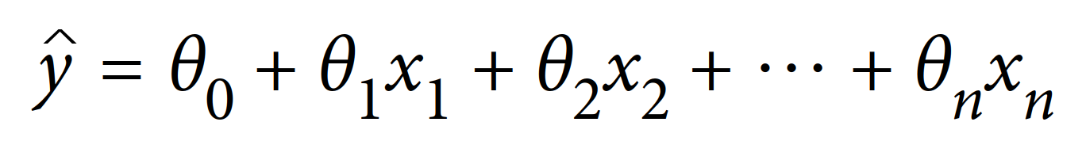















Hypothesis function of LR

Slide 7


Matrices and vectors

Slide 8






Matrix multiplication

Slide 9











Hypothesis function of LR (vectorized form)

Slide 10






What should be the “best” parameters for the hypothesis?

Slide 11
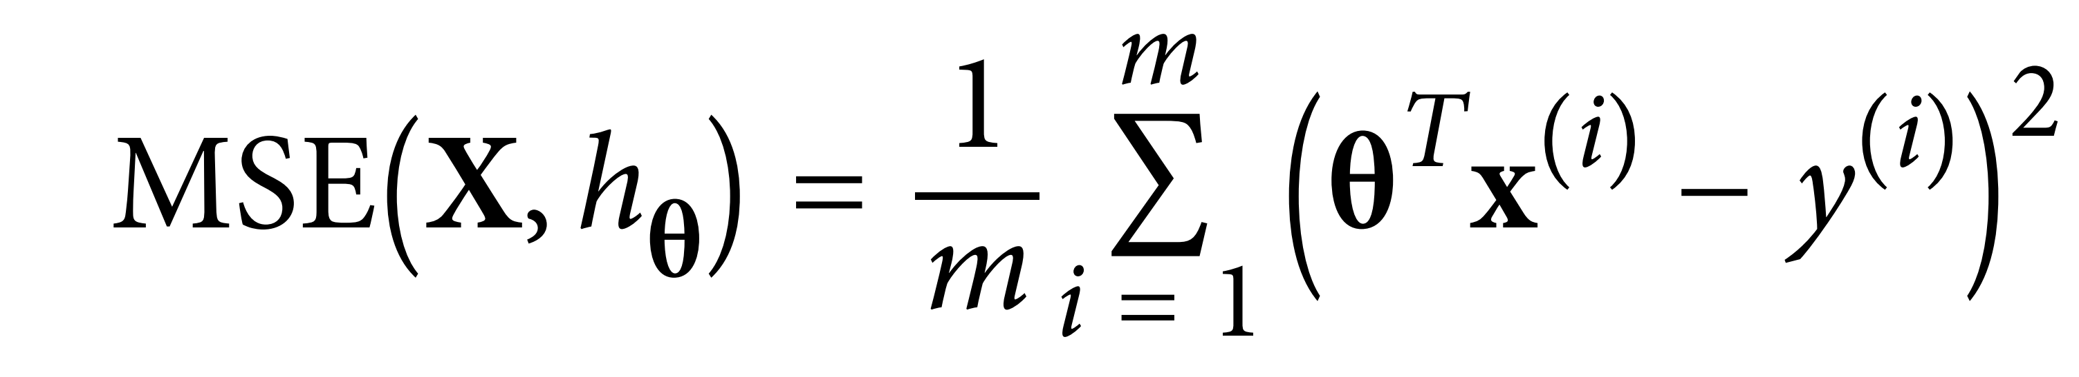


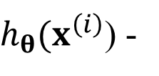


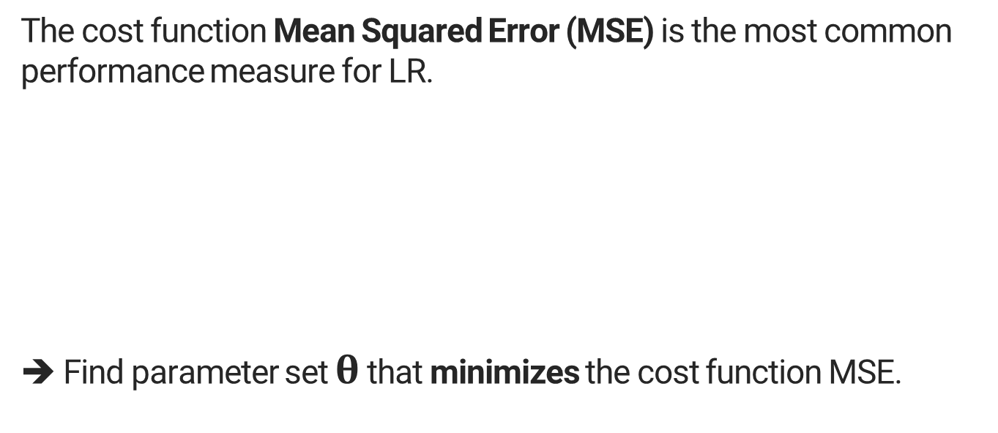

Cost function
The cost function Mean Squared Error (MSE) is the most common performance measure for LR.
➔ Find parameter set $θ$ that minimizes the cost function MSE.
$h_{θ}(x^{\left(ⅈ\right)}$) -

Slide 12
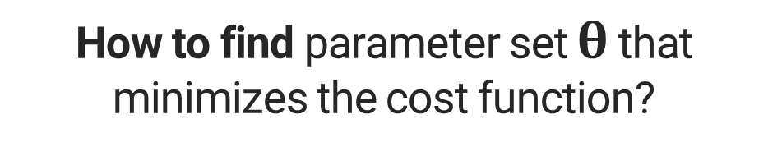
How to find parameter set $θ$ that minimizes the cost function?

Slide 13

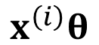
Method 1: Normal Equation
Take derivatives of the cost function w.r.t. parameters, and equal to zeros.
$$x^{\left(ⅈ\right)}θ$$

Slide 14
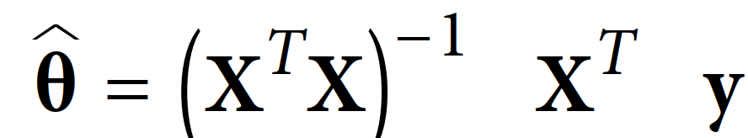







Normal equation solution
Solution (in vectorized form):

Slide 15






Computational complexity: Training
The Normal Equation computes the inverse of:
Computational complexity:
➔ very slow when the number of features grows large

Slide 16






Computational complexity: Prediction

Slide 18


Method 2: Gradient descent

Slide 19
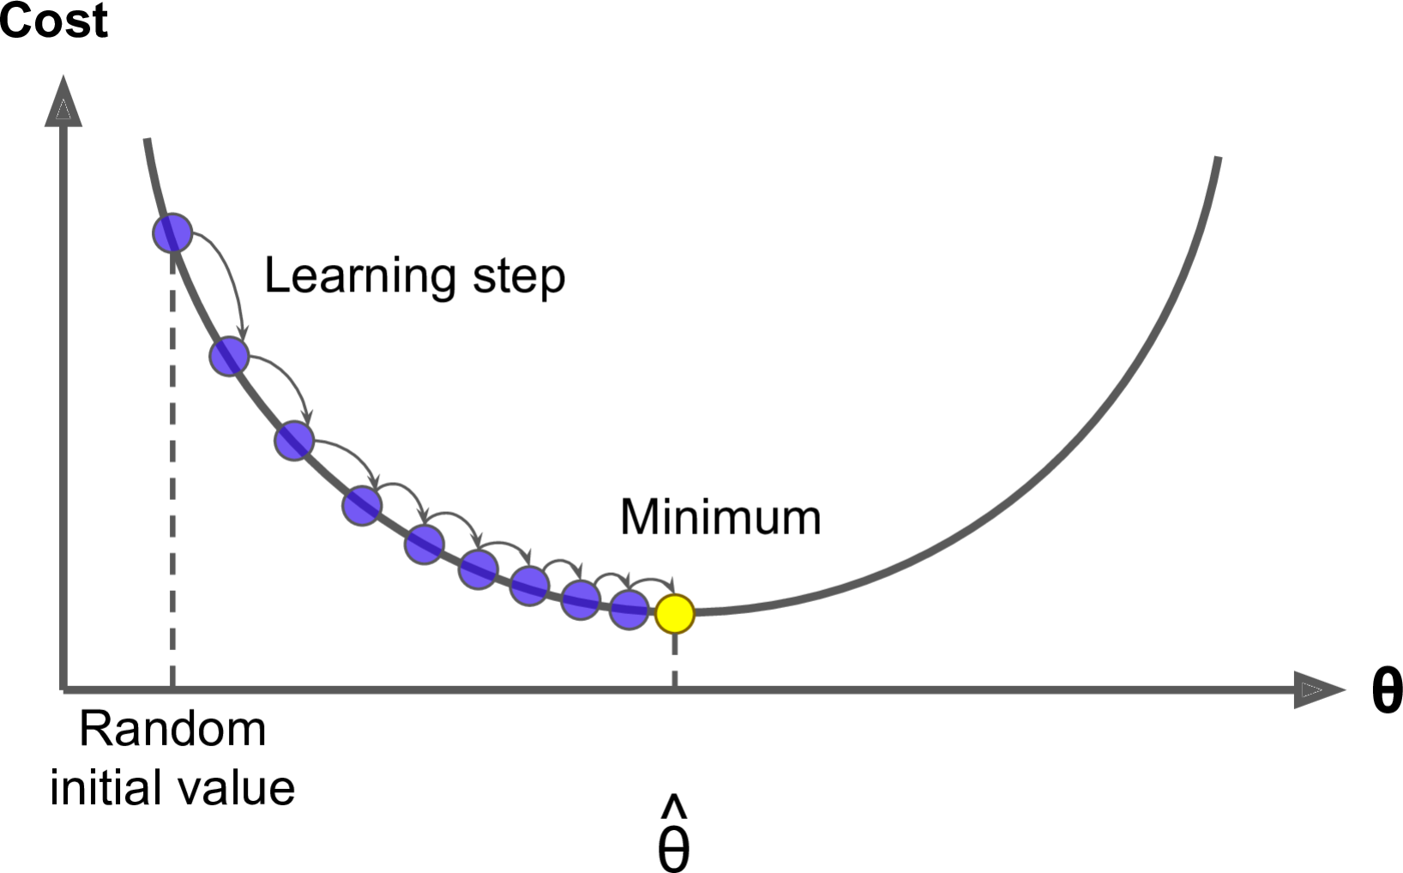
Idea

Slide 20







Gradient descent algorithm
repeat until convergence
{
}
➔ No matrix inversion: much faster than Normal Equation

Slide 21


Gradient: direction for parameters’ update
Gradient is the first derivative.

Slide 22
Gradient descent variants:
1. Batch gradient descent
2. Stochastic gradient descent
3. Mini-batch gradient descent

Slide 23
1. Batch gradient descent

Slide 24


Gradient descent algorithm
repeat until convergence
{
}

Slide 25
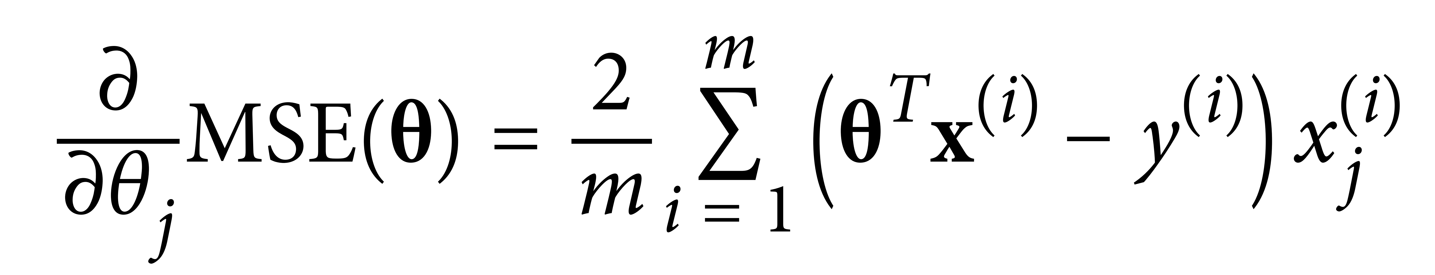
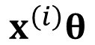
Compute gradients
Partial derivative of the cost function:
(Batch gradient descent (BGD))
$$x^{\left(ⅈ\right)}θ$$

Slide 26
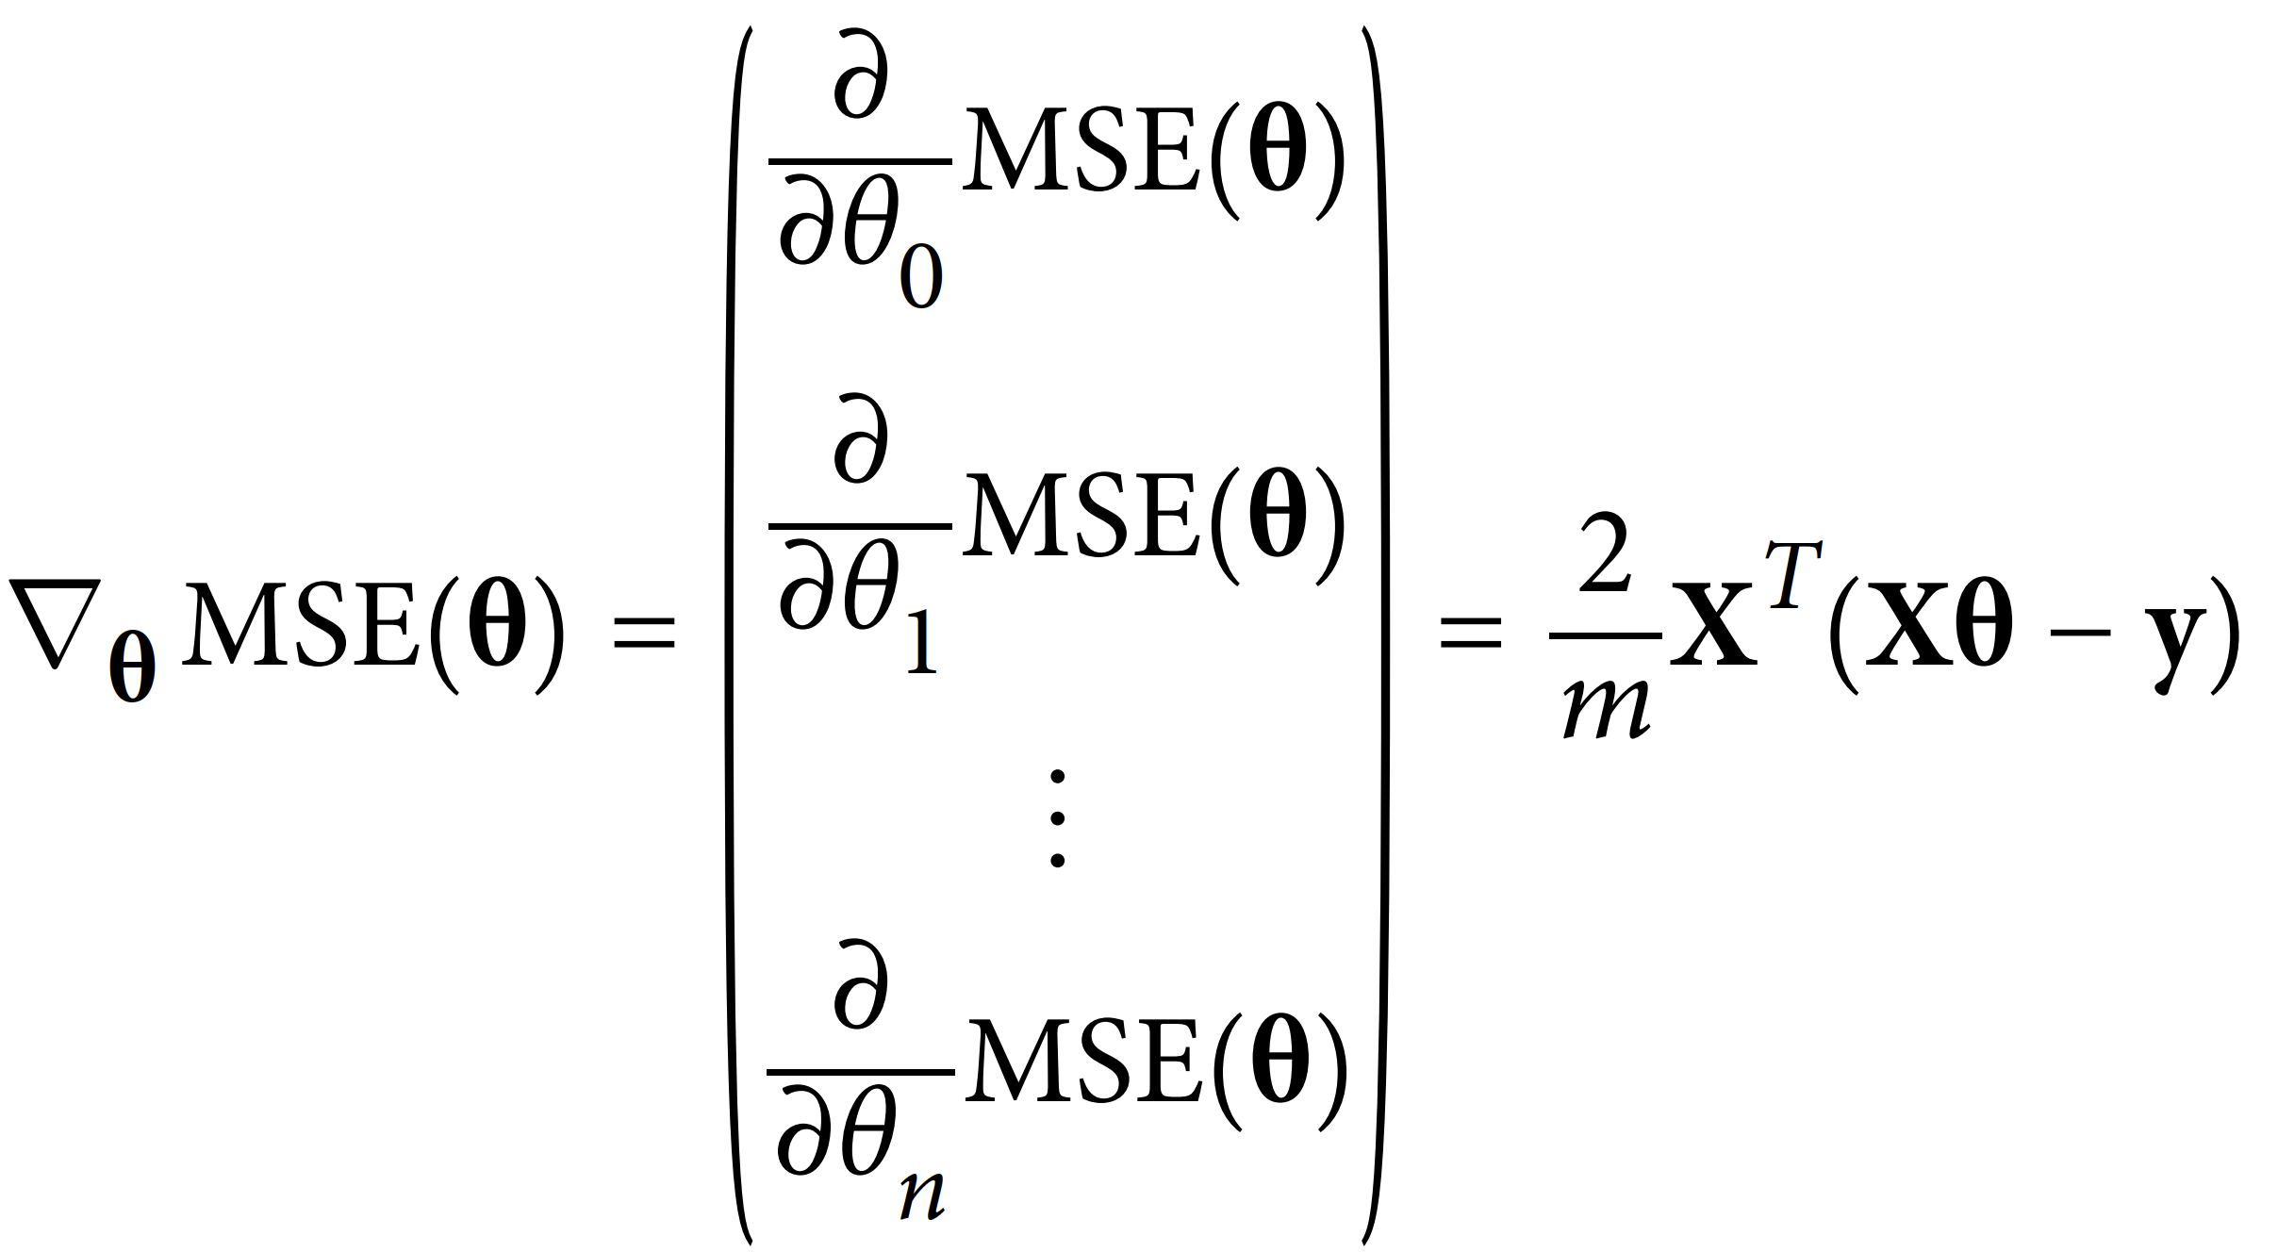

Compute gradients
Gradient vector
Source: (Gerón, 2019)

Slide 27



Implementation of BGD using Gradient vector
repeat until convergence
{
}
>> Go to code.

Slide 29
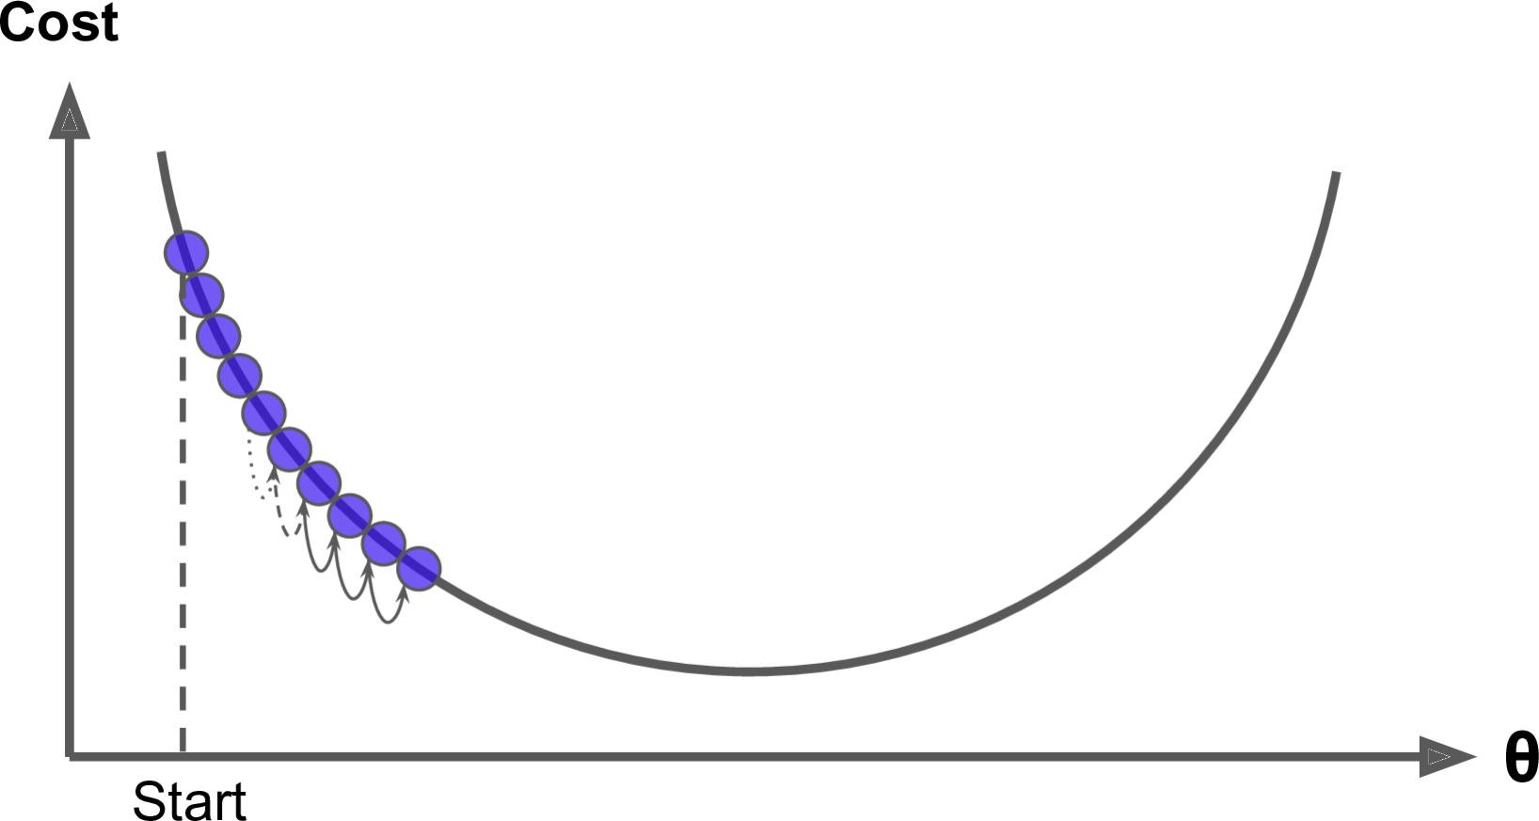

Learning rate
Small ➔ slow convergence

Slide 30
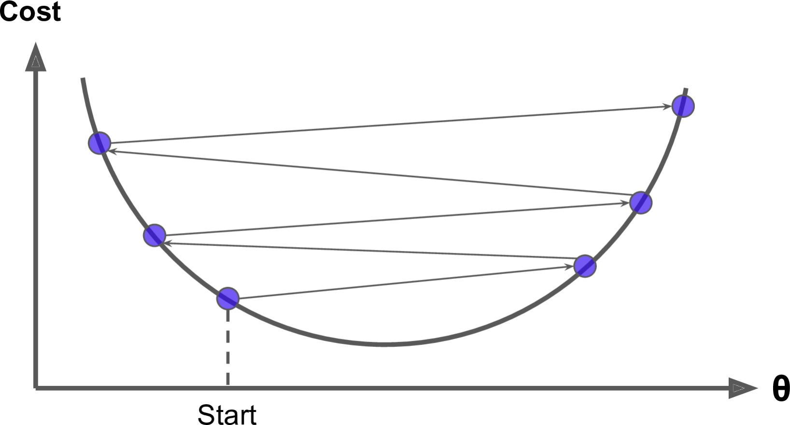
Learning rate
Large ➔ may no convergence

Slide 32
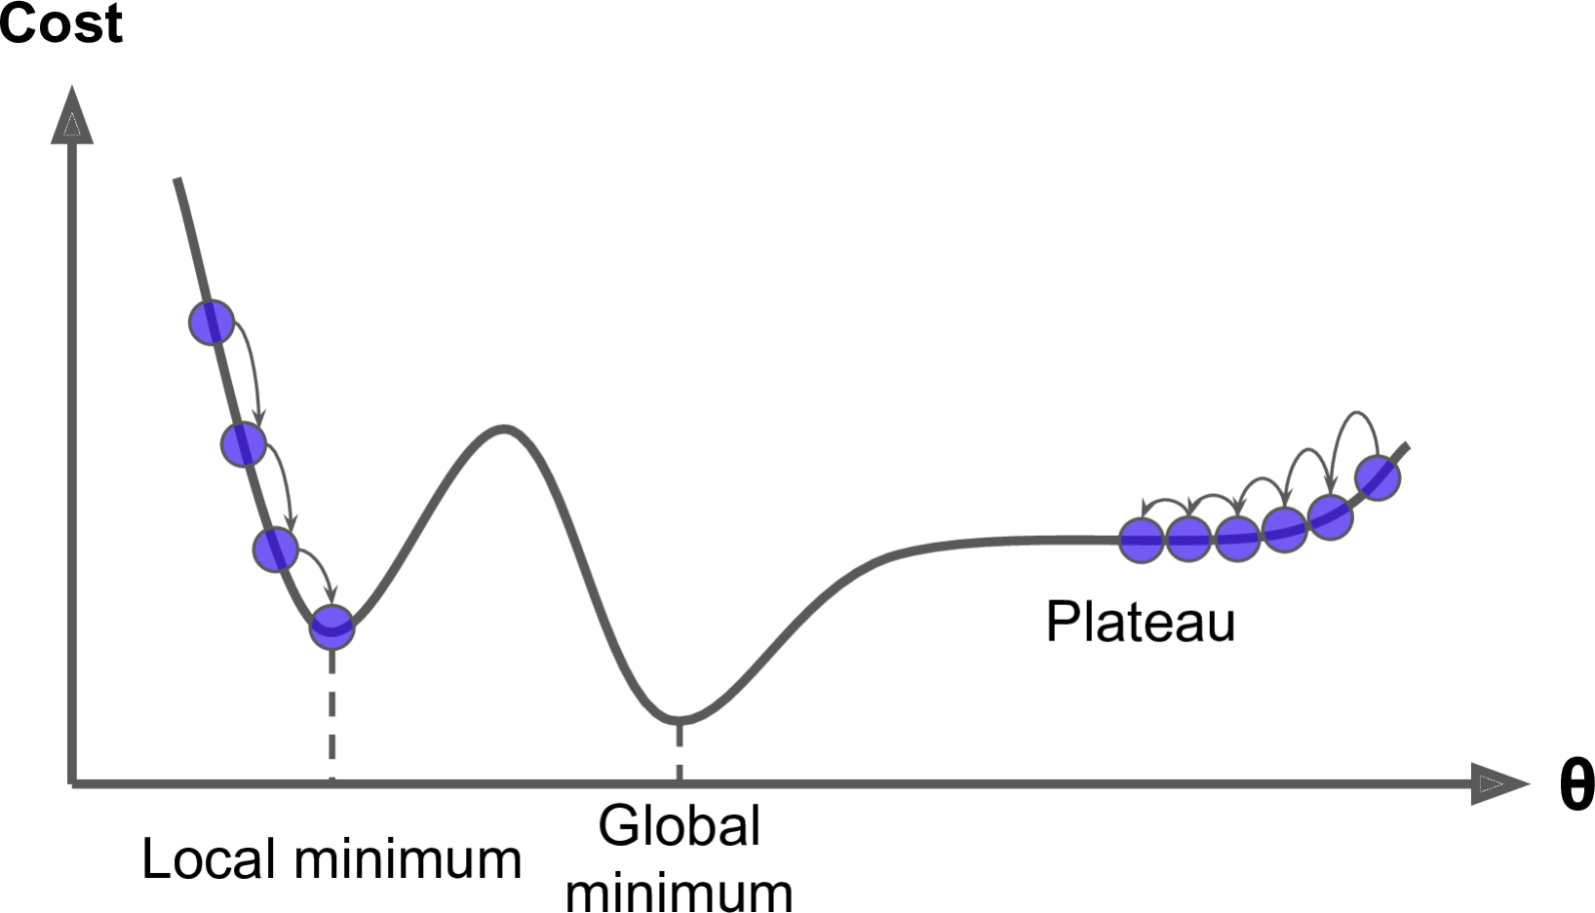




Problems of Gradient descent
1. Local minima

Slide 33
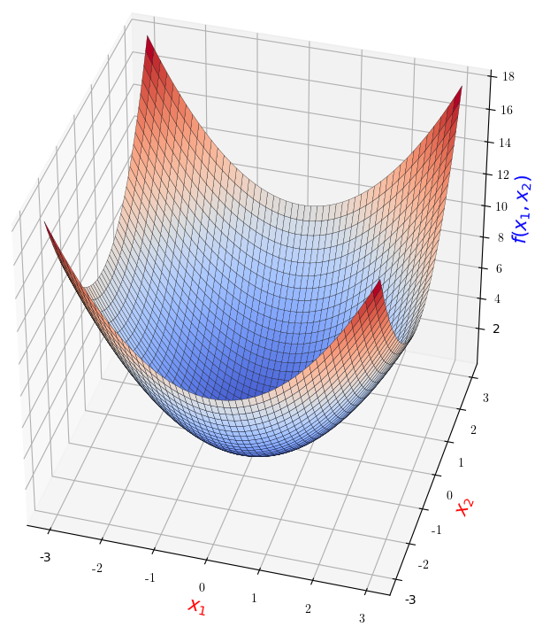


Problems of Gradient descent
2. Feature scales
Similar scales

Slide 34
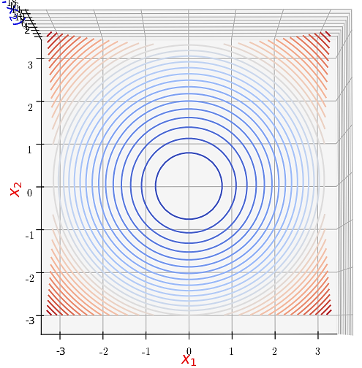


Problems of Gradient descent
2. Feature scales
Similar scales
(contour plot)

Slide 35
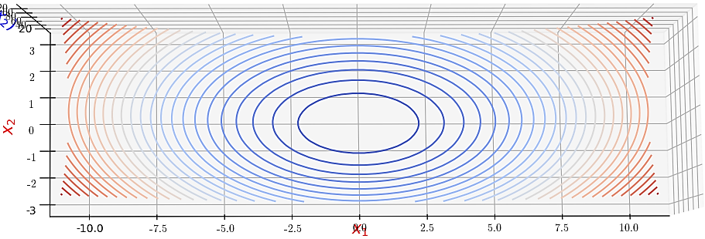
Problems of Gradient descent
2. Feature scales
(Very) Different scales
(contour plot)

